Slide 1
Secure Data Hiding in Image Using Steganography
CAPSTONE PROJECT
Presented By:
Student Name : MUKUL SHARMA
College Name & Department : MAHARAJA AGRASEN INSTITITUTE OF TECHNOLOGY (BTECH COMPUTER SCIENCE AND TECHNOLOGY)

Slide 2
OUTLINE
Problem Statement
Technology used
Wow factor
End users
Result
Conclusion
Git-hub Link
Future scope

Slide 3
Problem Statement
With the rise of digital communication, data security has become a major concern. This project focuses on embedding secret messages within images using steganography, ensuring secure data transmission without detection.

Slide 4
Technology used
Programming Language: Python
Libraries Used: OpenCV, os
Concepts: Image Processing, Pixel Manipulation, ASCII Encoding

Slide 5
Wow factors
Secret messages are embedded within image pixels using RGB channels.
A passcode-based decryption mechanism enhances security.
The system ensures that unauthorized users cannot retrieve the hidden data.
The process is seamless and does not distort the image significantly.

Slide 6
End users
Cybersecurity professionals
Digital forensic analysts
Individuals seeking secure communication
Journalists and activists needing confidential messaging

Slide 7
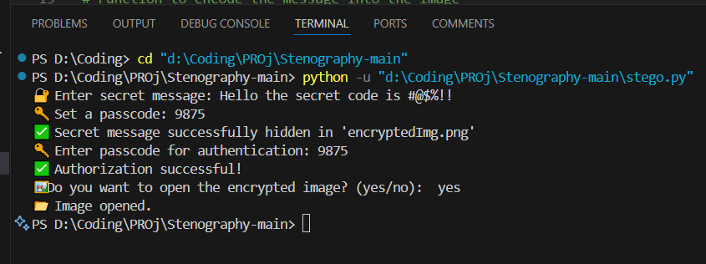
Results
Encrypting image and hiding secret message in it

Slide 8
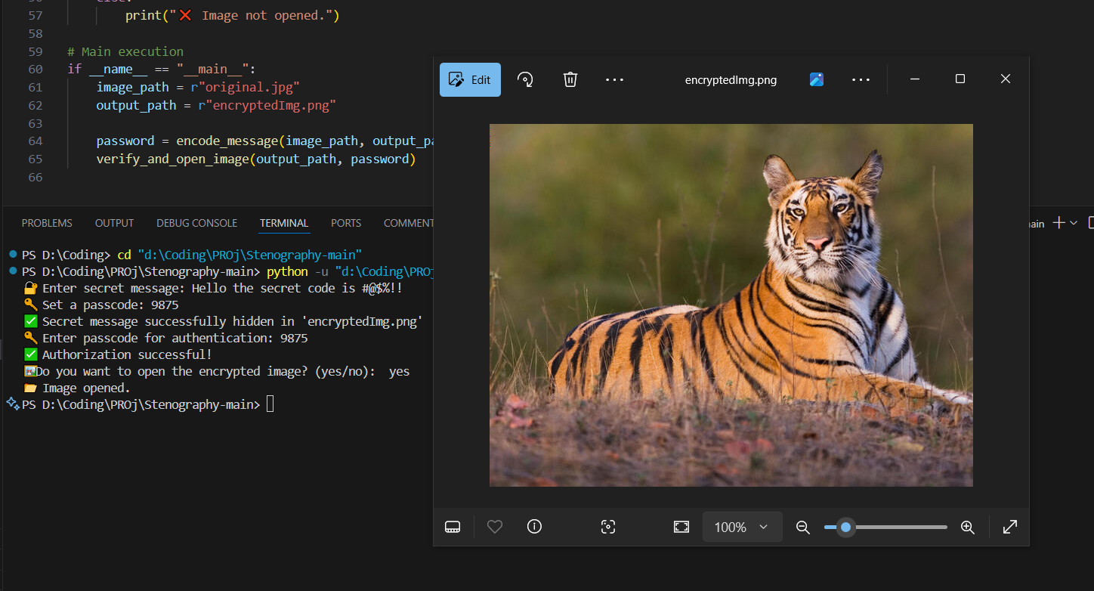
Encrypted image

Slide 9

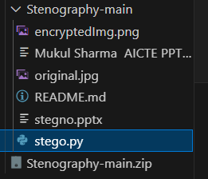
Folder before Encrypted Image
Folder after Encrypted Image

Slide 10
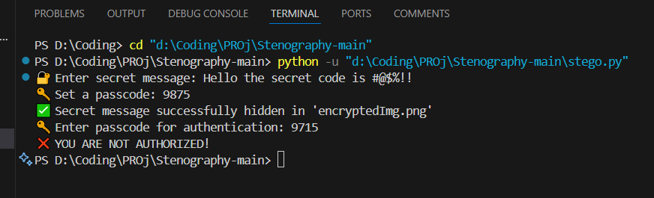
Authorization Failed

Slide 11
Conclusion
This project demonstrates a simple yet effective method for secure message transmission using image steganography. By embedding data at the pixel level and using a passcode for retrieval, the system ensures confidentiality and integrity.

Slide 12
GitHub Link
Make sure that there should be readme file

Slide 13
Future scope
Enhancing the algorithm to support multiple image formats and compression.
Implementing deep learning for automated steganalysis and detection prevention.
Developing a GUI-based application for user-friendly access.

Slide 14
THANK YOU

